Slide 1
PATIENT APPOINTMENT & NO-SHOW PREDICTION SYSTEM
CAPSTONE PROJECT
Presented By:
Student Name- Sneha Ray
College Name- Maulana Abul Kalam Azad University of Technology, West Bengal
Department - BBA
4. AICTE ID - STU6a63217bd69621784881531

Slide 2
OUTLINE
Problem Statement (Should not include solution)
Proposed System/Solution
System Development Approach (Technology Used)
Algorithm & Deployment
Result
Conclusion
Future Scope
References

Slide 3
PROBLEM STATEMENT
Patient Appointment & No-Show Prediction System
Clinics frequently face appointment cancellations and patient no-shows, resulting in unused appointment slots, reduced operational efficiency and difficulty managing doctor schedules.
Clinic staff generally do not have an intelligent system to identify which upcoming appointments have a higher probability of being missed.
Therefore, there is a need for a system that can manage appointments while analyzing historical attendance information to identify potential no-show risk.

Slide 4
PROPOSED SOLUTION
The proposed system, ClinicCare, is a healthcare appointment management and no-show prediction platform.
It provides:
Patient registration and login
Doctor and department listing
Appointment booking
Appointment rescheduling
Appointment cancellation
Admin dashboard
No-show risk prediction
Reminder simulation
Appointment analytics
Reports
Intelligent workflow
Patient Appointment
↓
Patient History
↓
Feature Analysis
↓
No-Show Prediction
↓
Low / Medium / High
↓
Reminder Recommendation
↓
Admin Dashboard

Slide 5
SYSTEM APPROACH
Component | Technology
Frontend | React.js
Build Tool | Vite
Backend | [actual technology]
Database | [actual database]
Machine Learning | Python + scikit-learn
Charts | [actual library]
Authentication | [actual implementation]
Deployment | [platform]
Version Control | Git + GitHub

Slide 6
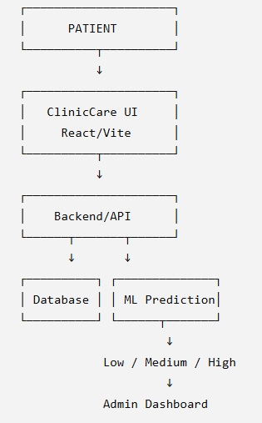
ALGORITHM & DEPLOYMENT
Workflow:
Deployment: Streamlit-based web application.
Output:
No-show probability
↓
Risk classification
↓
LOW / MEDIUM / HIGH

Slide 7
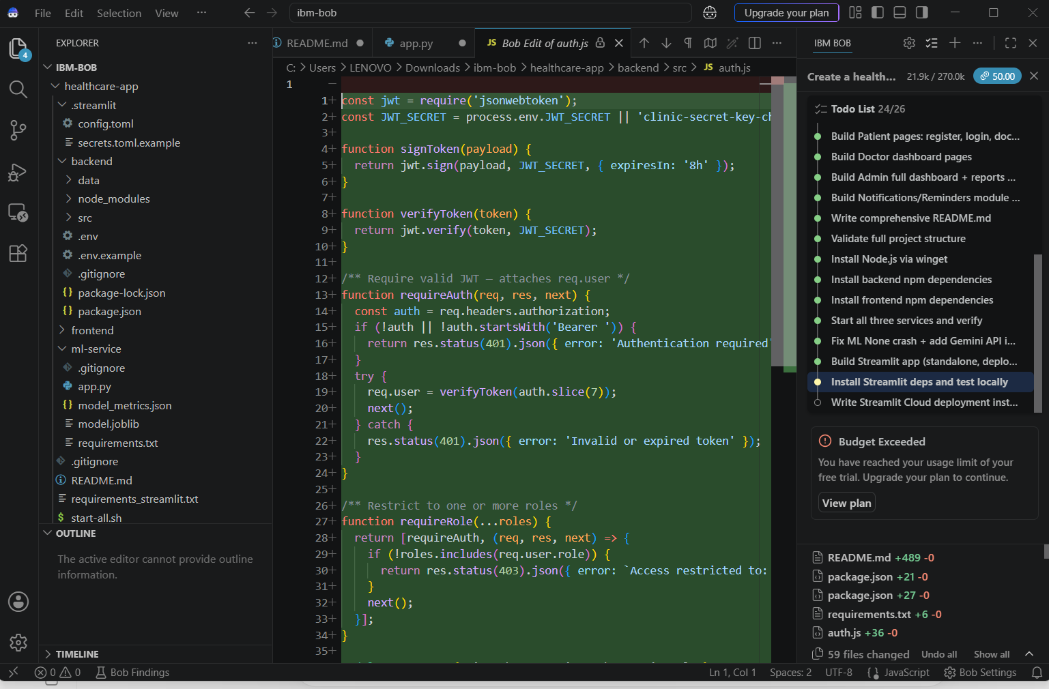
RESULT

Slide 8
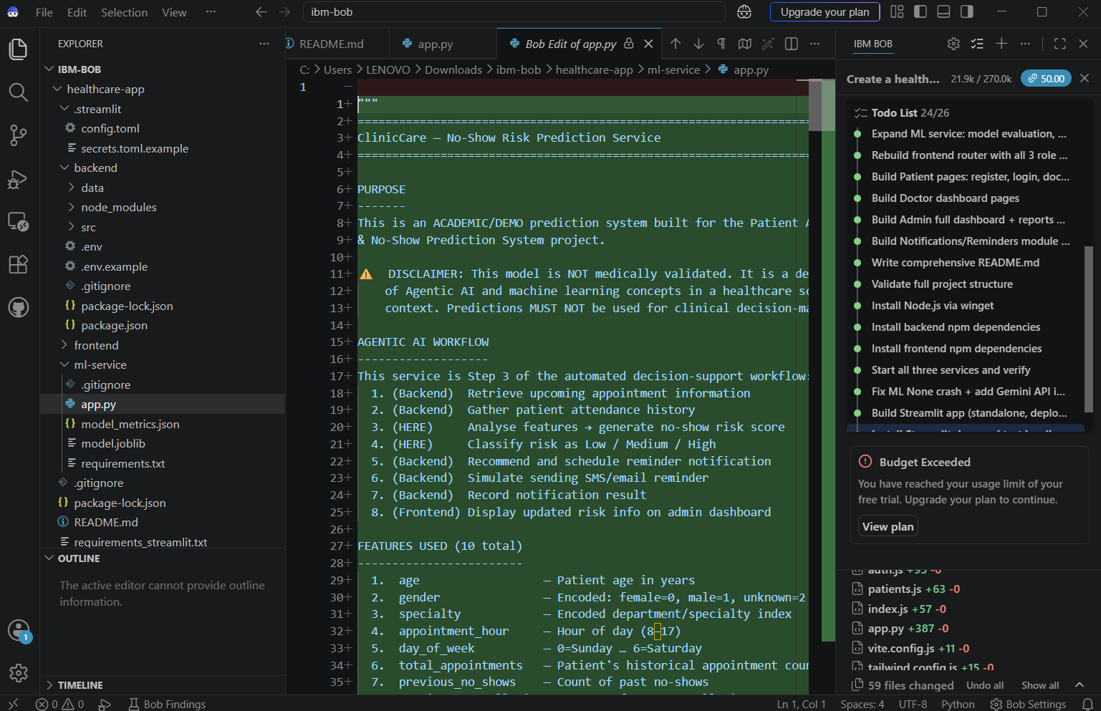
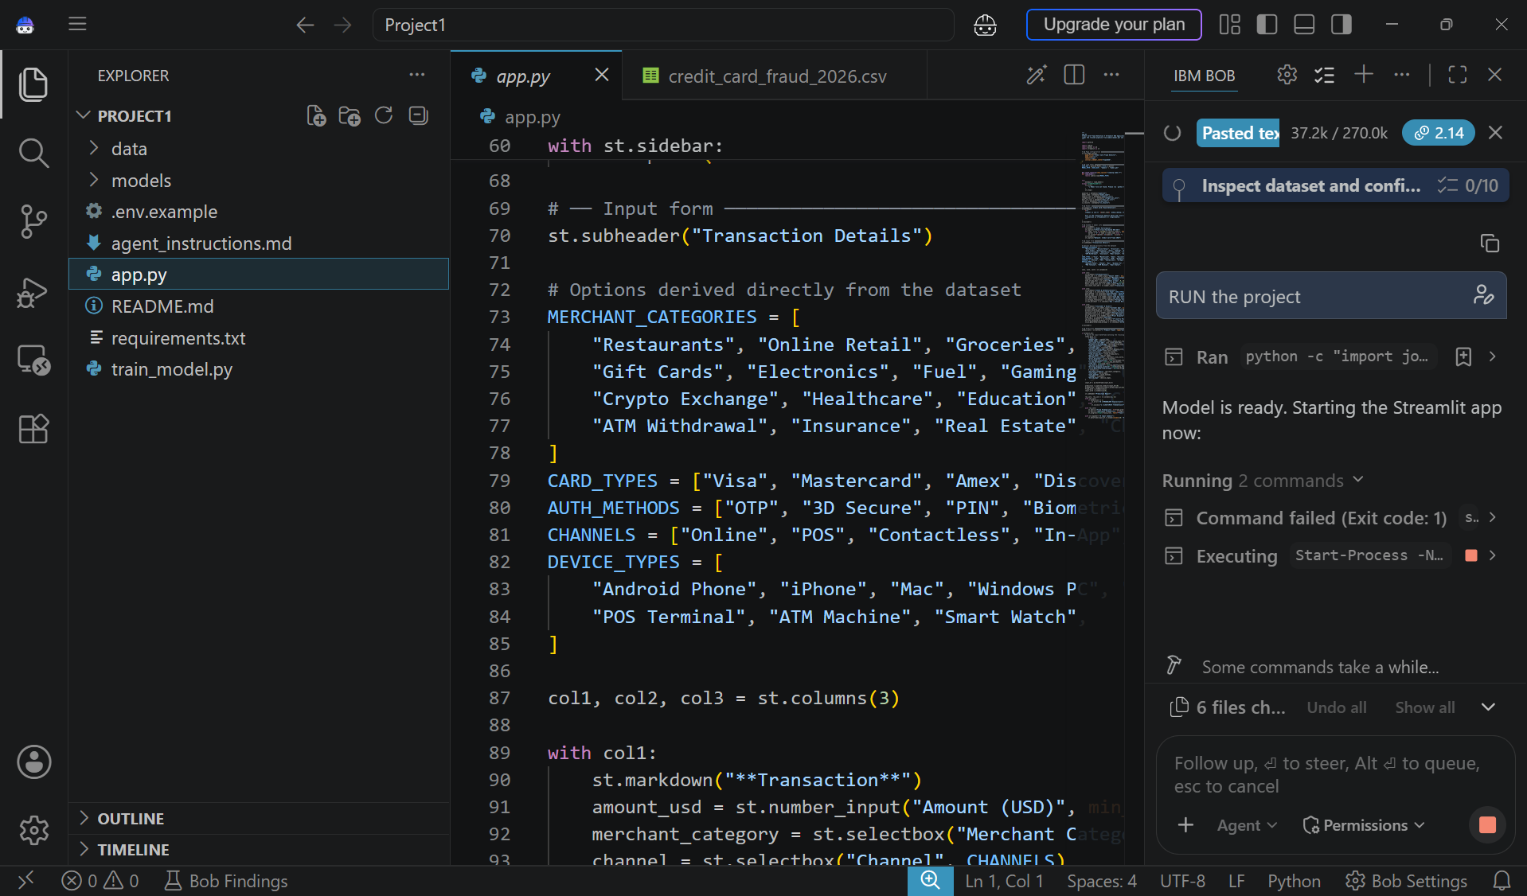
RESULT

Slide 9
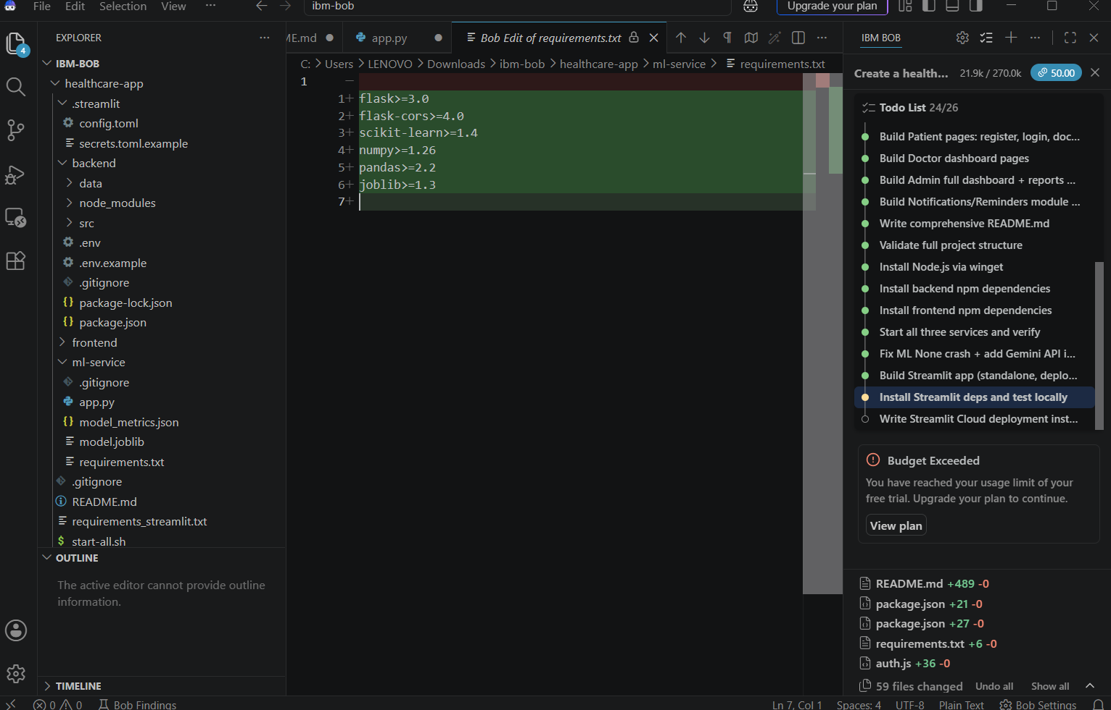
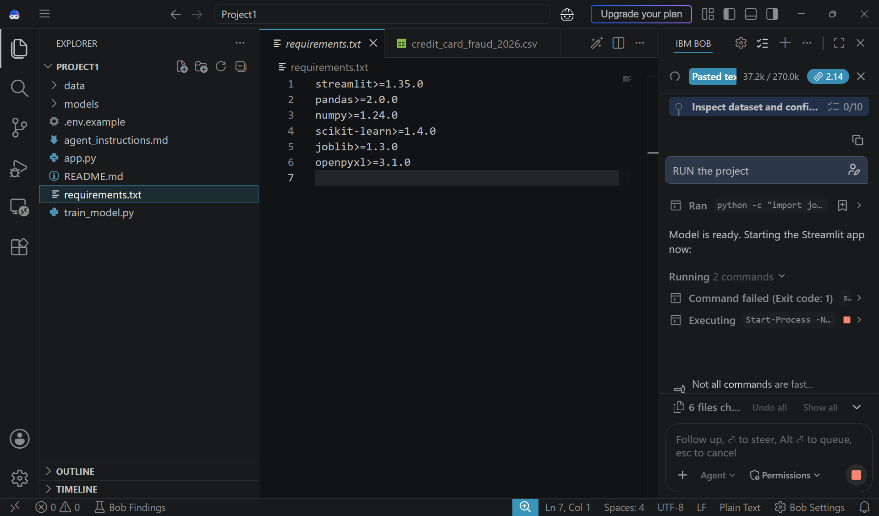
RESULT

Slide 10
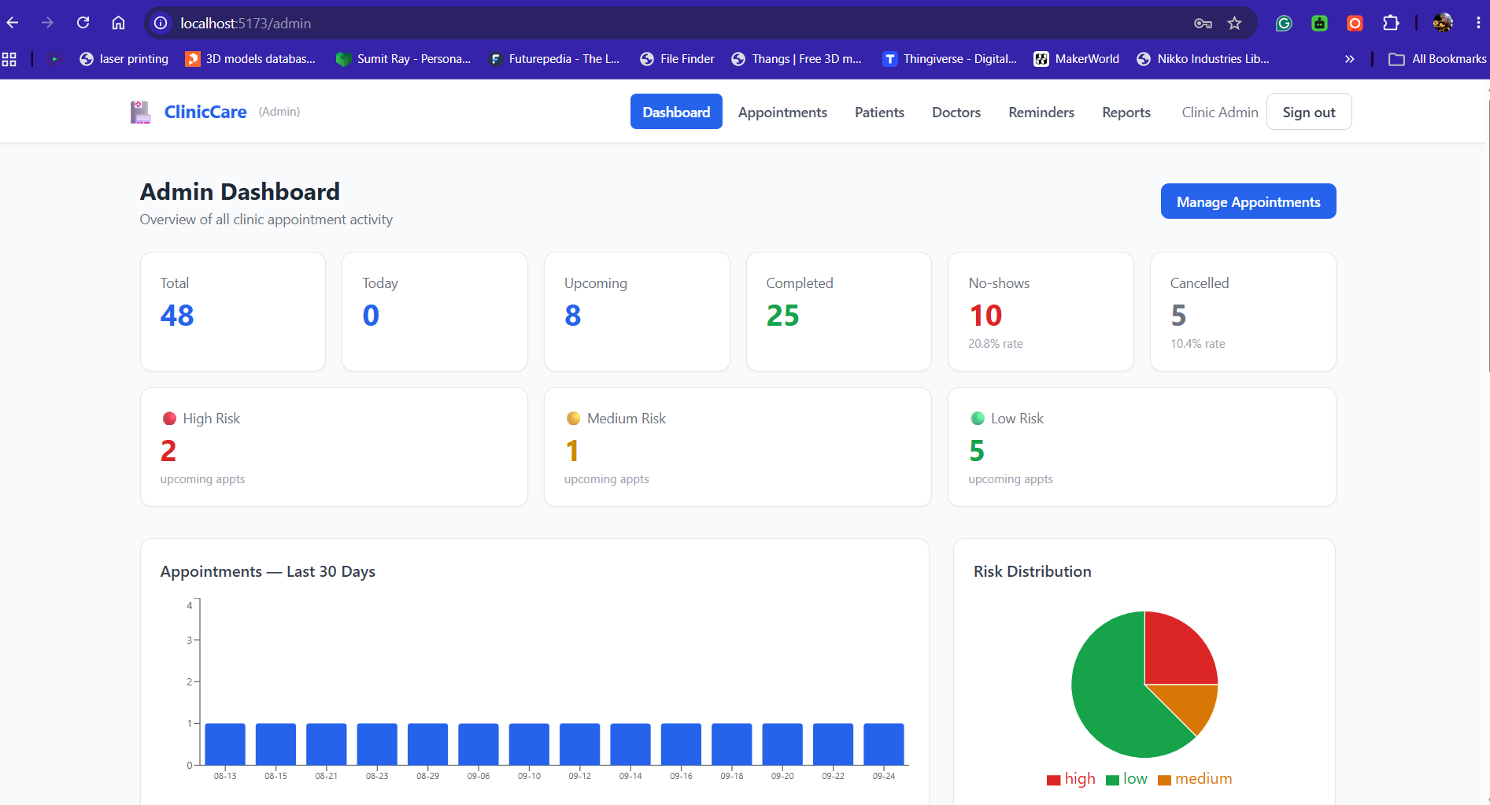
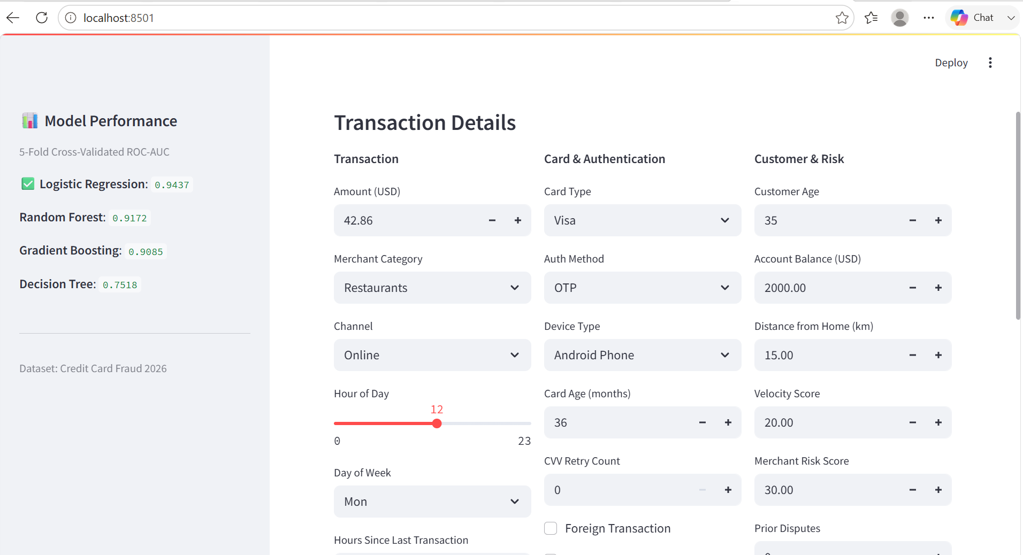
RESULT

Slide 11
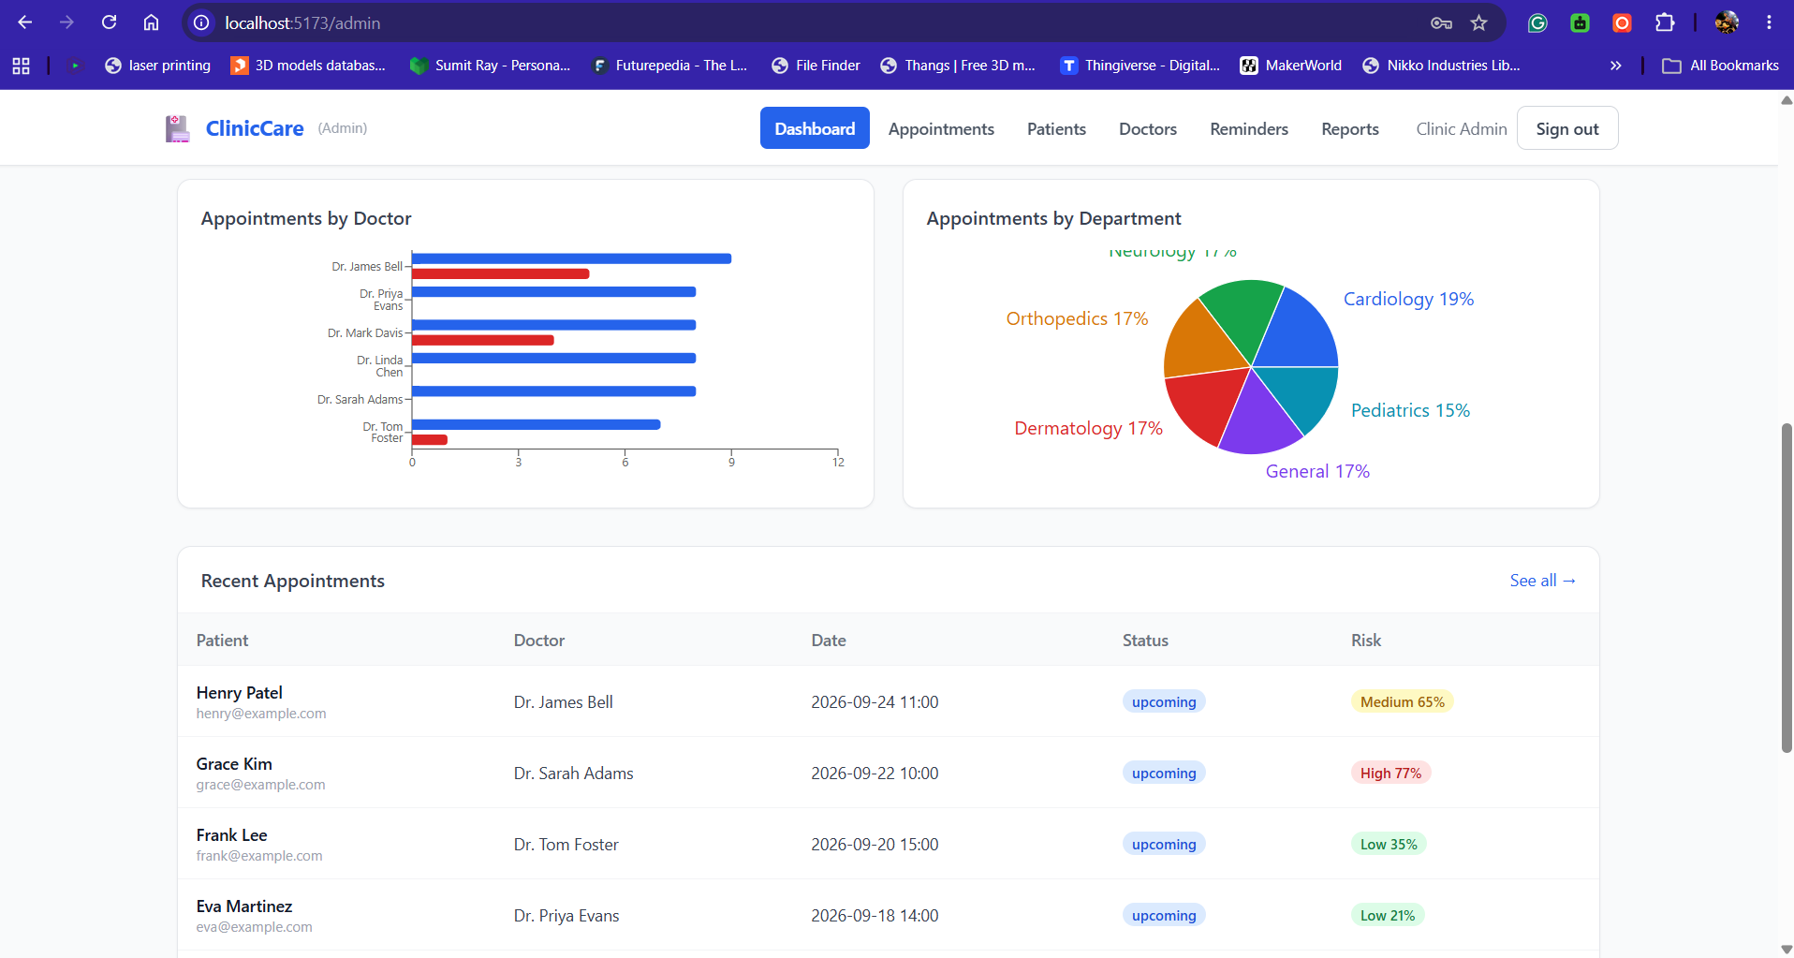
RESULT

Slide 12
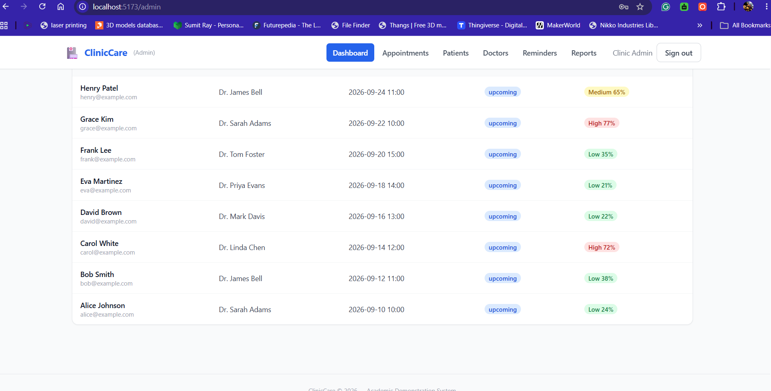
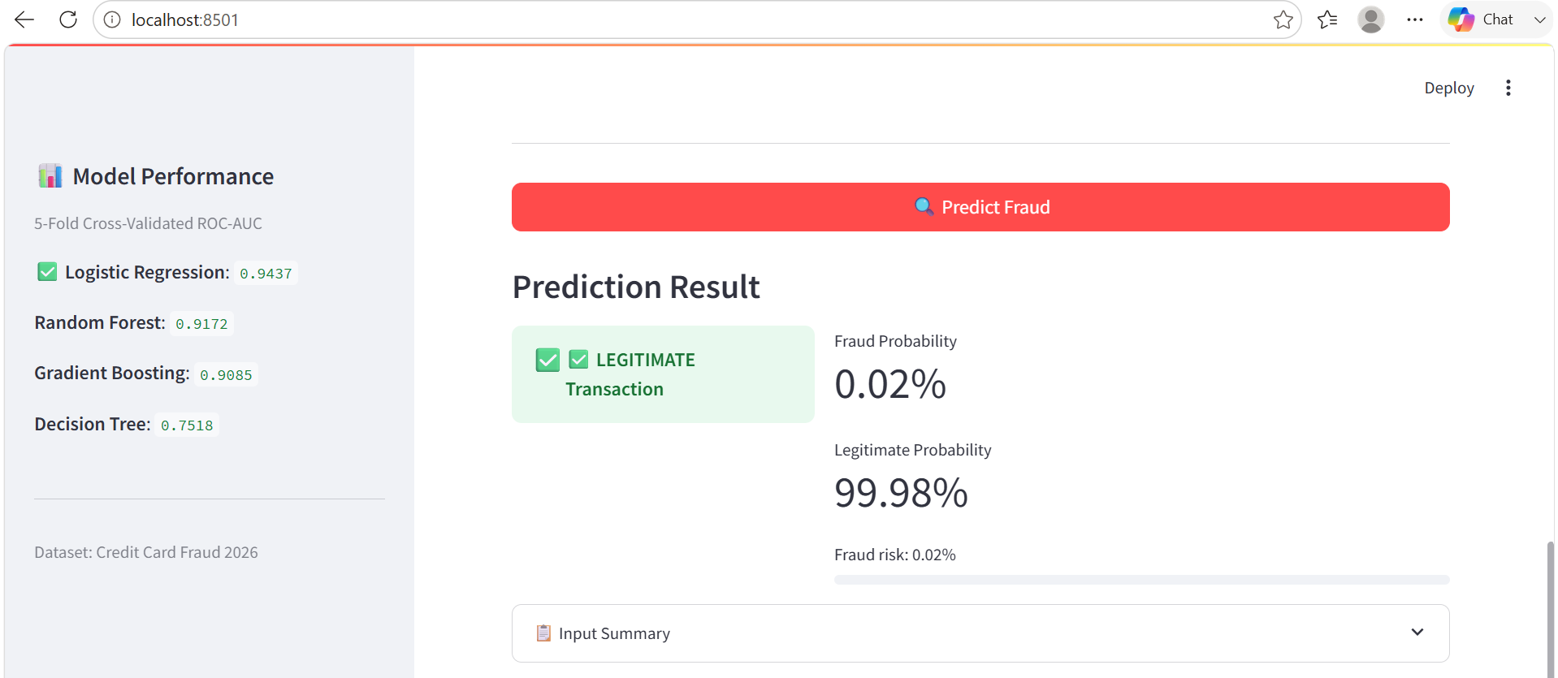
RESULT

Slide 13
CONCLUSION
The ClinicCare – Patient Appointment & No-Show Prediction System provides an integrated solution for managing healthcare appointments and identifying patients who may be at risk of missing their appointments.
The system enables patient registration, doctor selection, appointment booking, rescheduling, and cancellation.
Separate dashboards are provided for Patients, Doctors, and Administrators.
A Machine Learning model using Logistic Regression predicts the probability of appointment no-shows.
Appointments are classified into Low, Medium, and High risk categories.
The system demonstrates an Agentic AI workflow by combining risk assessment, reminder scheduling, notification simulation, and dashboard updates.
The Admin dashboard provides useful appointment statistics, risk distribution, doctor load, and reports.
The project demonstrates how AI and automation can support better appointment management and clinic operations.

Slide 14
FUTURE SCOPE
PostgreSQL Database: Replace the current SQLite database with PostgreSQL for better production scalability and concurrent access.
Real SMS & Email: Integrate services such as Twilio and email APIs for actual appointment reminders.
Automatic Scheduling: Introduce cron/job scheduling so the reminder workflow runs automatically without manual initiation.
Advanced ML Models: Compare Logistic Regression with Random Forest, Gradient Boosting, or other suitable models.
Real Anonymised Data: Retrain and validate the model using properly anonymised real-world data with appropriate ethical approval.
Real-Time Dashboard: Add WebSocket-based updates so administrators can see appointment changes instantly.
Email Verification: Add verification during patient registration.
Doctor Availability Management: Allow doctors/admins to manage schedules and availability through a calendar.
Report Export: Provide CSV/PDF export for appointment and analytics reports.
Mobile Application: Develop a React Native mobile application for patients and healthcare staff.
Telehealth: Add video consultation capabilities for remote appointments.

Slide 15
REFERENCES
Python Documentation — Python Software Foundation
scikit-learn Documentation — Machine Learning in Python
Flask Documentation — Python Web Framework
React Documentation — User Interface Library
Vite Documentation — Frontend Build Tool
Node.js Documentation — JavaScript Runtime
SQLite Documentation — Database System
IBM Bob — AI-assisted Development Tool
ClinicCare Project README & Documentation
GitHub Repository — Project Source Code

Slide 16
DEPLOYMENT LINK / GITHUB LINK
Github Link: https://github.com/sneharay399-ray/cliniccare-patient-appointment-no-show-prediction
Deployment: HF, Streamlit Link, Gradio (OPTIONAL)
Streamlit : https://cliniccare-patient-appointment-no-show-prediction-ory8qv66hdsd.streamlit.app/

Slide 17
THANK YOU

